Slide 1
Speech Emotion Recognition
By:-
Krishna Purwar 2201CS40

Slide 2

Importance of Predicting Emotions in Conversations
Understanding Emotional Context: Emotions influence how people communicate. Identifying if someone is in an angry or happy mood provides context for their words, tone, and behavior.
For instance:
An angry tone might indicate frustration, not necessarily a personal attack.
A happy tone may suggest openness and willingness to engage.
Avoiding Miscommunication: Emotional states affect word choice and interpretation. Misjudging an angry remark as rude instead of stress-related can escalate conflicts unnecessarily.

Slide 3

Role of Emotions in Online Communication
Why Emotion Prediction Is Crucial
Improves Communication:
Respond appropriately based on participants’ emotional states.
Diffuse anger or frustration with a calm tone.
Builds Empathy:
Acknowledge others' feelings to foster trust and collaboration.
Enhances Productivity:
Address emotional barriers (e.g., stress) that impact focus.
General Overview
Non-verbal cues (body language, facial expressions) are often reduced in online communication.
Emotions affect productivity, decision-making, and relationships.

Slide 4






Tech Stack
Python:
The backbone of the project, used for scripting, data processing, and model implementation.
Scikit-learn:
Utilized for machine learning algorithms and evaluation metrics.
PyTorch:
For developing and training deep learning models with flexibility and performance.
HTML:
Structured the web interface with semantic elements.
CSS:
Designed and styled the user interface for an appealing look.
Javascript & Python:
Enabled dynamic functionality and interactivity in the web application.

Slide 5
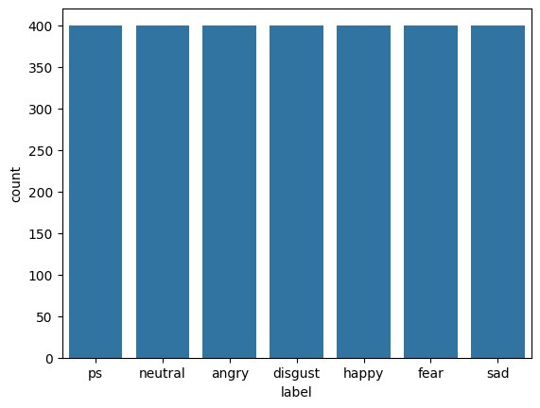
Dataset
Tess Dataset
The Toronto Emotional Speech Set (TESS) is a publicly available dataset designed for emotion recognition research.
It consists of recordings from two female speakers (aged 26 and 64) enunciating 200 target words in seven different emotions.
Number of Samples: 2800 audio recordings (200 words × 7 emotions × 2 speakers).
Audio Format: WAV files, recorded at 16-bit, 44.1 kHz.
Speech Content: Short sentences and words designed to express a wide range of emotions clearly.
Emotions: Angry, Happy, Sad, Fear, Neutral, Disgust, Surprised

Slide 6
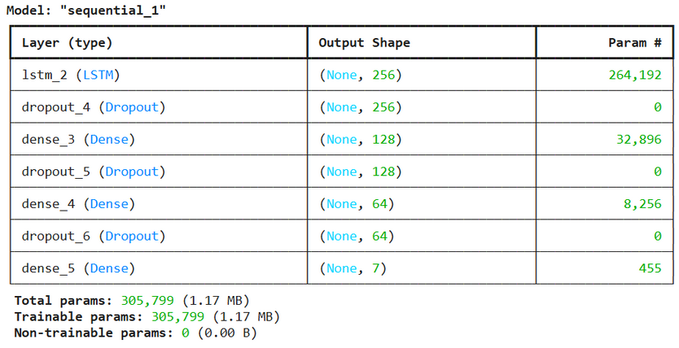
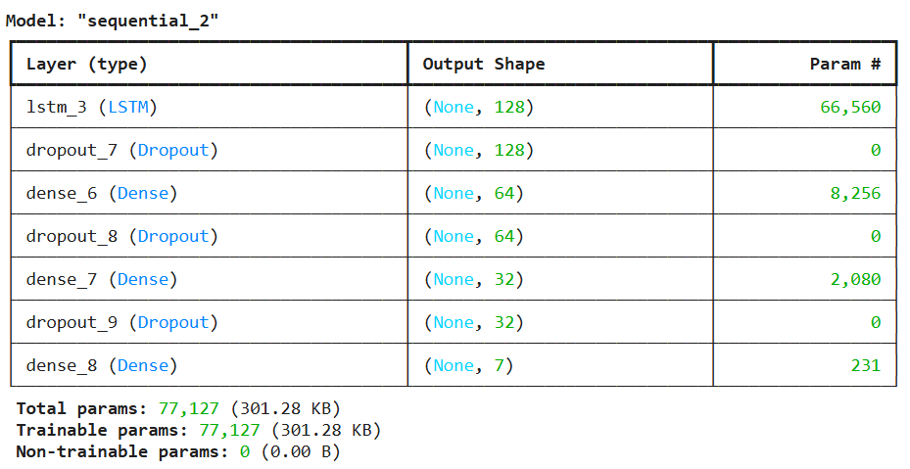
Models Used in SER
LSTM Model
Model Overview:
Two LSTM models with 128 units and 256 units, respectively.
Designed for temporal analysis of audio features (sequence data).
Architecture Highlights:
Input Shape: (60, 1) (time steps × features).
Key Layers:
LSTM layers with ReLU activation.
Fully connected Dense layers for classification.
Dropout layers to prevent overfitting.
Purpose:
Benchmark model for comparing performance against other architectures.
Demonstrated robust results in recognizing speech emotions.

Slide 7
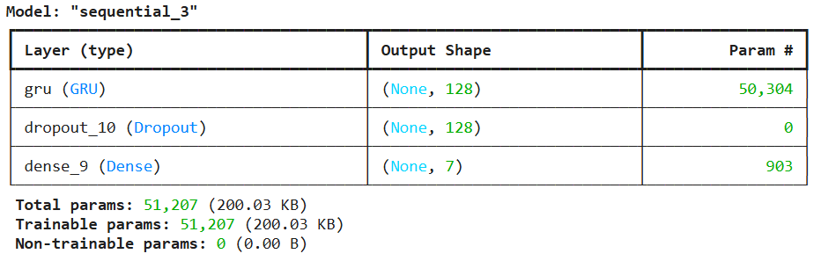
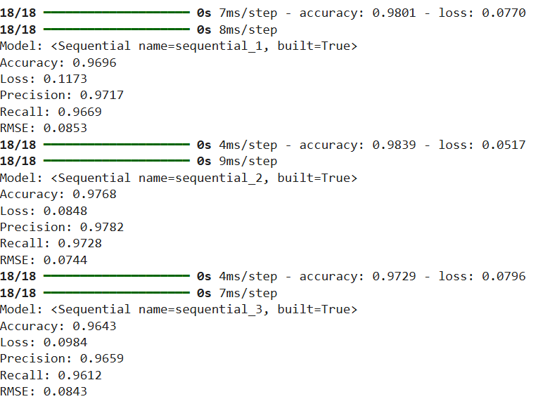
Models Used in SER
2. GRU Model
Model Overview:
Gated Recurrent Unit (GRU) model for efficient sequence processing.
Optimized to reduce computational complexity compared to LSTM.
Architecture Highlights:
Single GRU layer with 128 units.
Dense layers for classification with softmax activation.
Incorporates Dropout for generalization.
Key Strength:
Lightweight compared to LSTMs with similar accuracy.
Faster training and inference times.

Slide 8
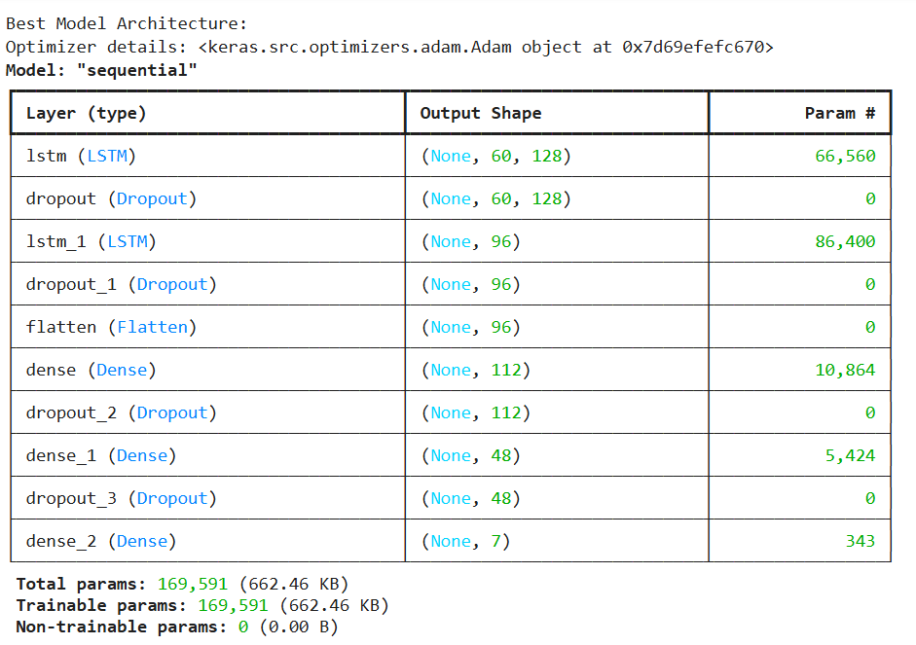
Models Used in SER
3. Neural Architecture Search
Objective:
Automate the search for the best-performing model architecture.
Approach:
Conducted NAS to compare LSTM, GRU, and other model configurations.
Evaluated combinations of hyperparameters, layer units, and activation functions.
Outcome:
Identified the optimal architecture with improved accuracy and computational efficiency.
Enabled data-driven model selection instead of manual experimentation.

Slide 9
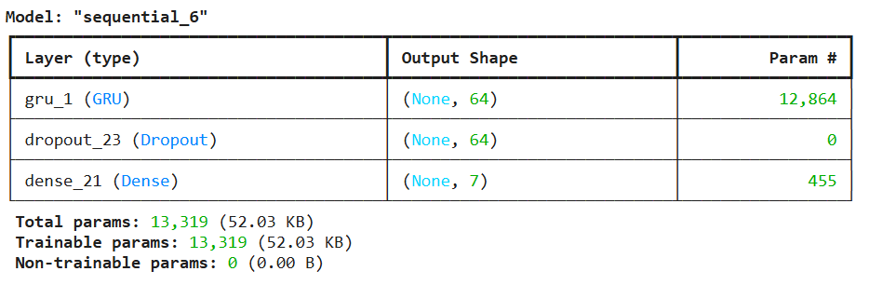
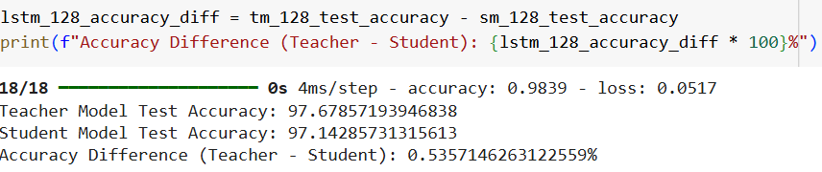
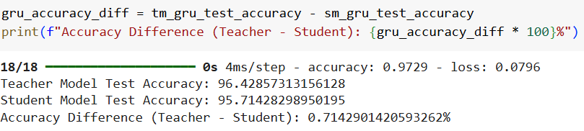
Models Used in SER
4. Knowledge Distillation for Lightweight Student Models
What is Knowledge Distillation?
A technique where a larger "teacher model" transfers its knowledge to smaller "student models."
Applications:
Teacher Models:
Wav2Vec2 and optimal LSTM/GRU models.
Student Models:
Simplified versions of LSTM and GRU architectures.
Benefits:
Achieved comparable accuracy to teacher models.
Reduced model size and inference time for deployment on resource-constrained devices.
Outcome:
Successfully deployed lightweight models with high efficiency.

Slide 10
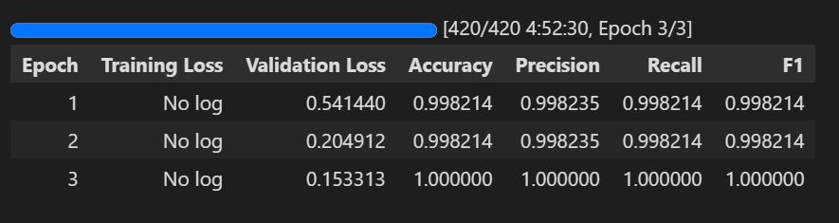
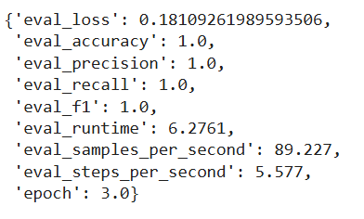
Models Used in SER
5. Wav2Vec2 Fined Tuned Model
Model Overview:
Pre-trained Wav2Vec2 model fine-tuned on emotion recognition tasks.
Leveraged rich audio representations for feature extraction.
Why Wav2Vec2?:
State-of-the-art performance in speech-related tasks.
Pre-trained on vast speech datasets, offering robust feature embeddings.
Fine Tuning Process:
Customized classification head for emotion prediction.
Trained on TESS datasets.
Outcome:
Outperformed traditional LSTM and GRU models in accuracy.

Slide 11
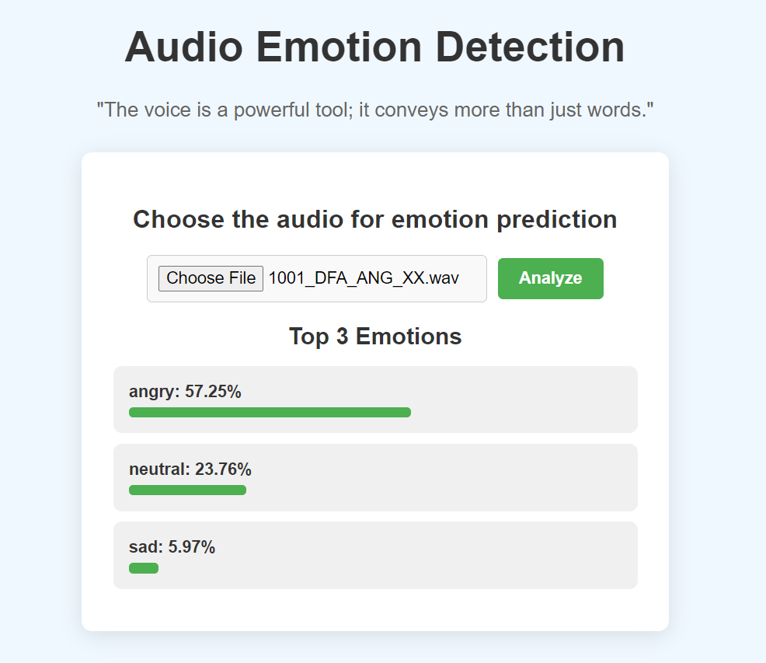
Local Deployment on Web Page
Model Overview:
Wav2Vec2: A state-of-the-art speech processing model that extracts meaningful features from raw audio to accurately predict emotions.
Deployment Details:
Backend: Hosted using Python and Flask to handle user interactions and process audio through the Wav2Vec2 model.
Frontend: Developed a user-friendly interface using HTML, CSS, and JavaScript for seamless interaction.
Integrated libraries like PyTorch for efficient model execution.
Workflow:
Users upload audio files through the web interface.
The Wav2Vec2 model processes the audio to predict emotions such as happy, angry, or sad.
Results are displayed instantly in an intuitive, user-friendly format on the webpage.

Slide 12
THANK YOU ☺️

